Slide 1
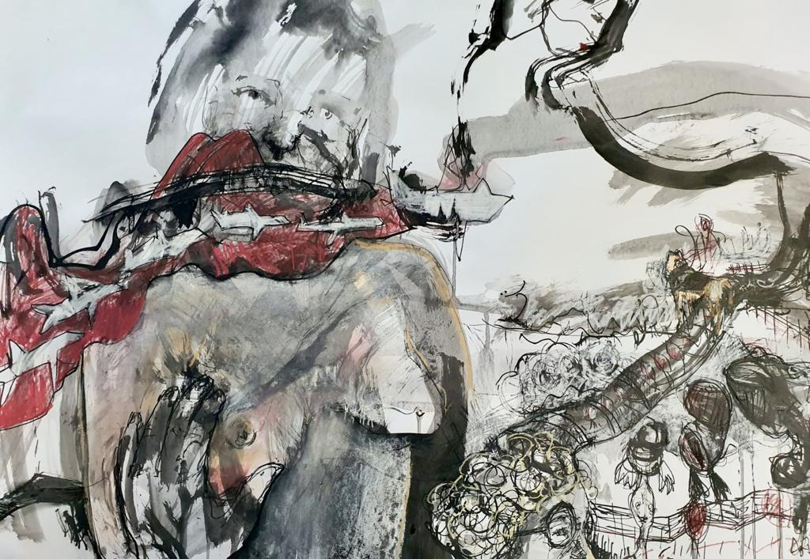
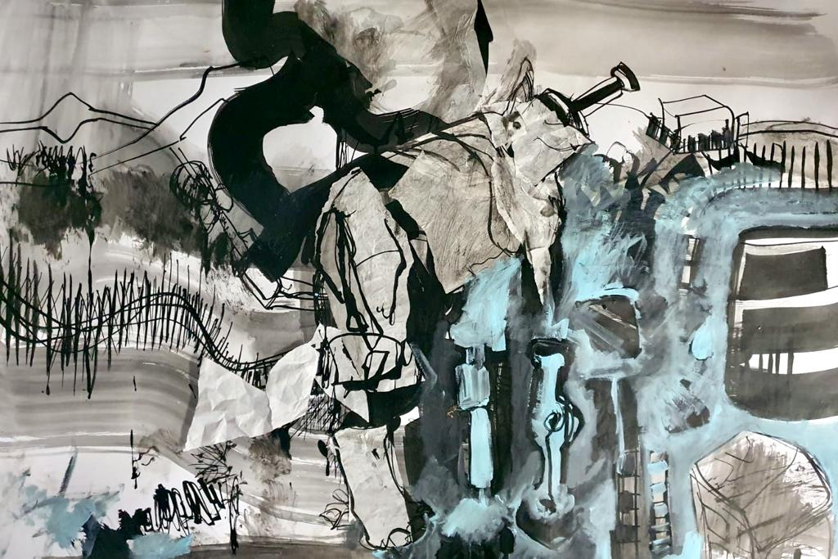
Title: She sells sea shells Media: ink and mixed media on paper Framed
Size unframed: 68x61 My price: R12000
Title: Pig iron Media: ink and mixed media on paper Framed
Size unframed: 68x61 My price: R12000

Slide 2
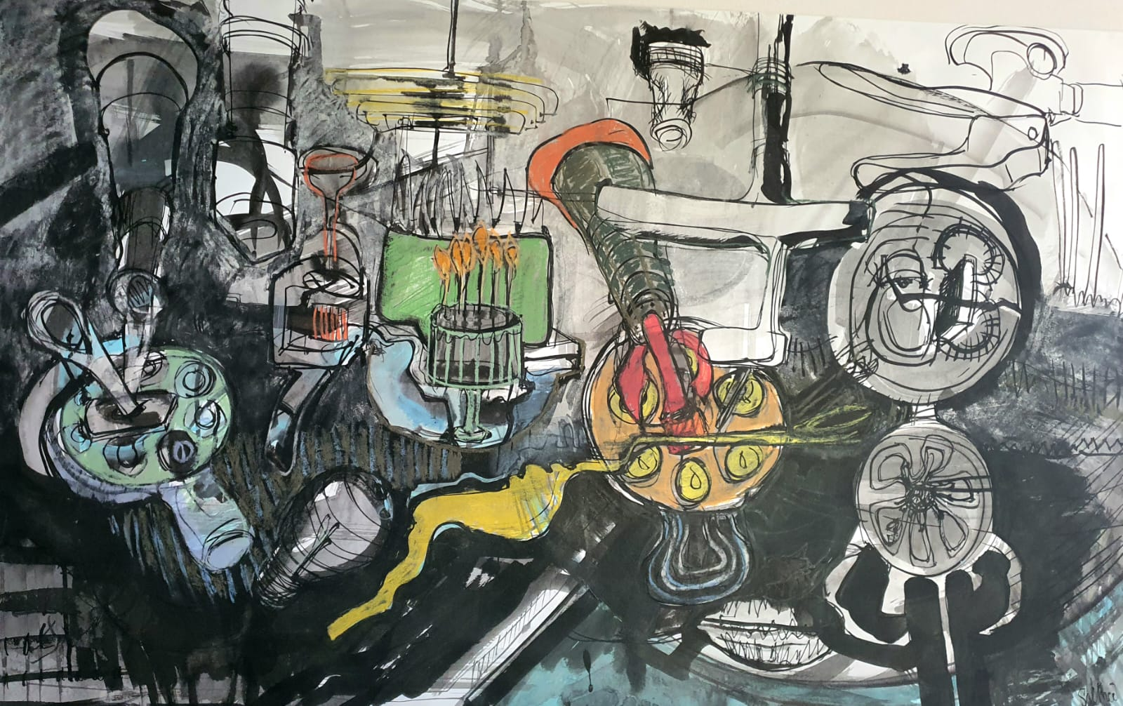
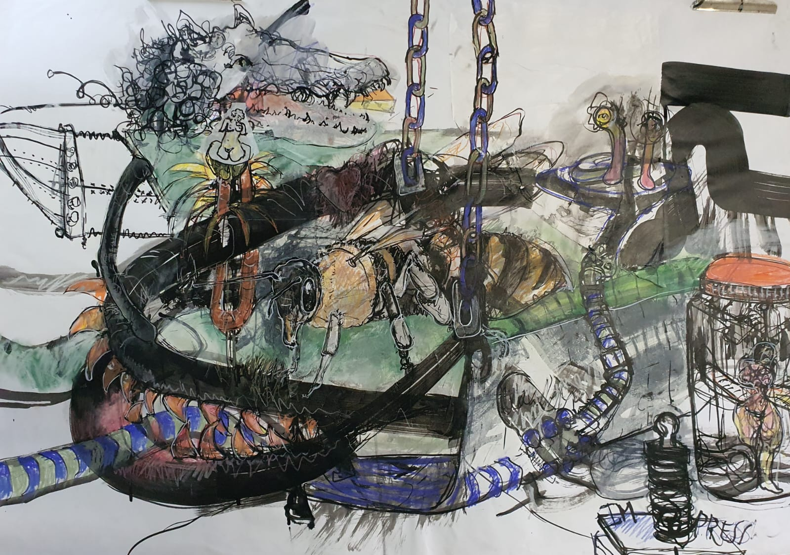
Title: It's the small things Media: ink and mixed media on paper Framed
Size unframed: 68x61 My price: R12000
Title: Entrapment Media: ink and mixed media on paper Framed
Size unframed: 68x61 My price: R12000

Slide 3
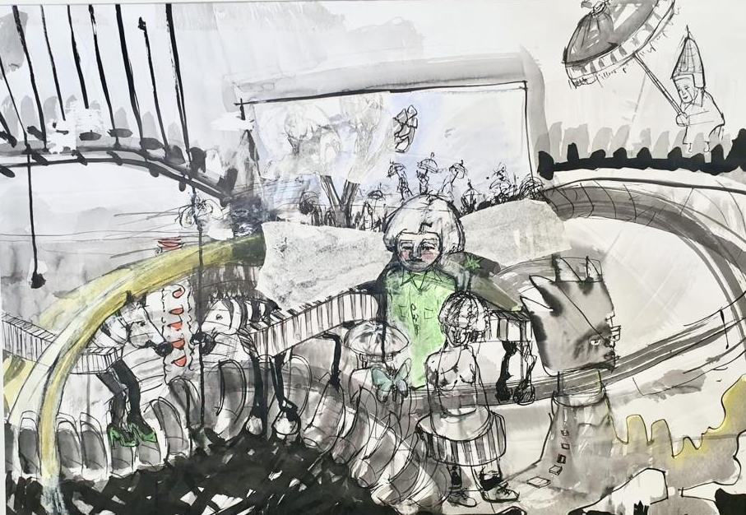
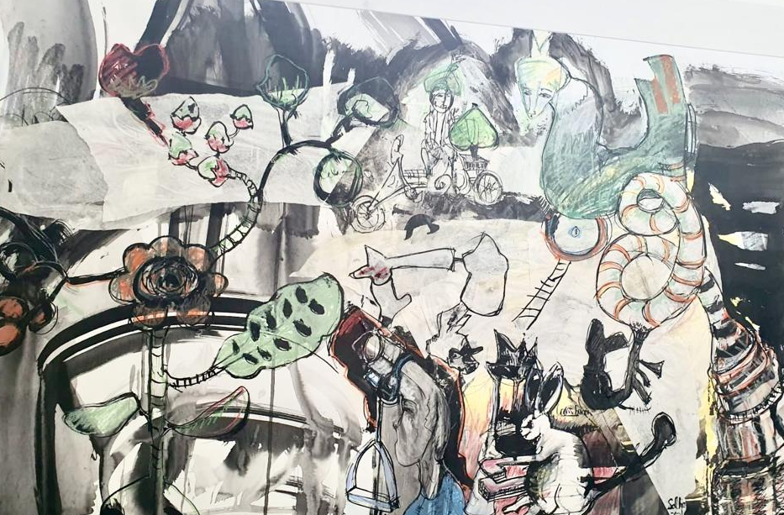
Title: Into the ethereal Media: ink and mixed media on paper Framed
Size unframed: 68x61 My price: R12000
Title: Cross bunnies Media: ink and mixed media on paper Framed
Size unframed: 68x61 My price: R12000

Slide 4
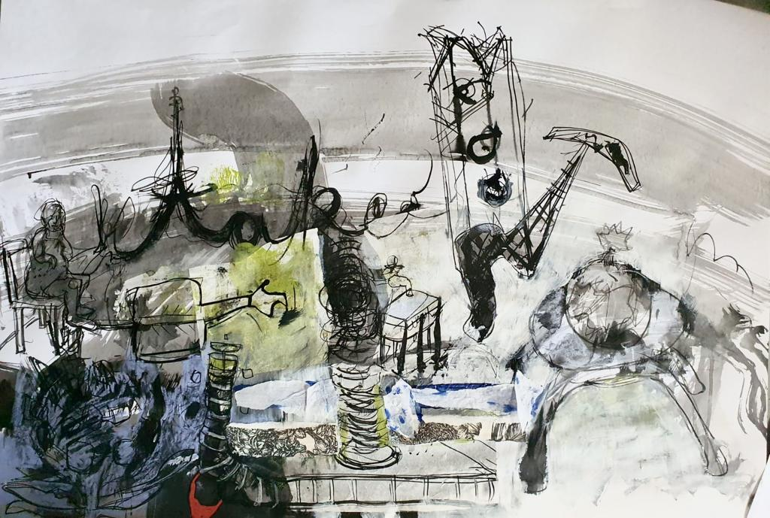
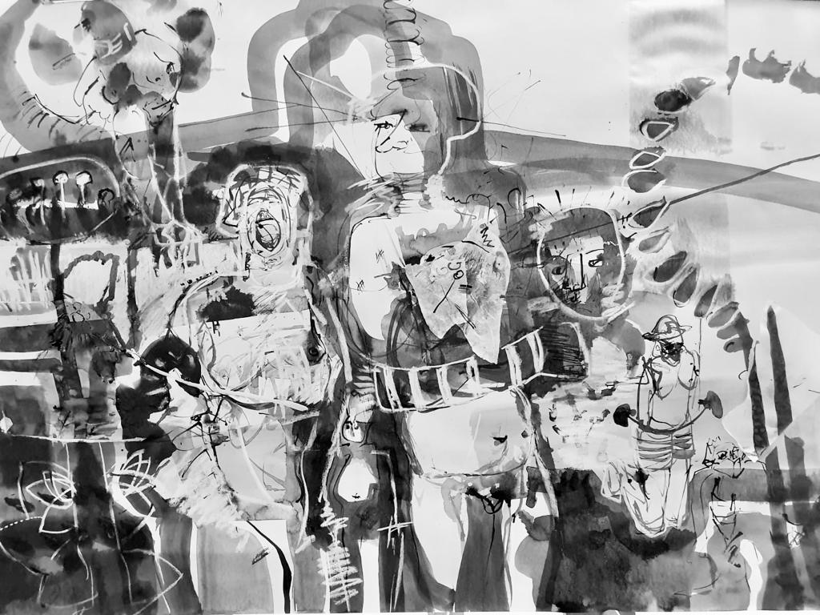
Title: Taken Media: ink and mixed media on paper Framed
Size unframed: 68x61 My price: R12000
Title: So baby you've got me in the shape I'm in Media: ink and mixed media on paper Framed
Size unframed: 68x61 My price: R12000

Slide 5
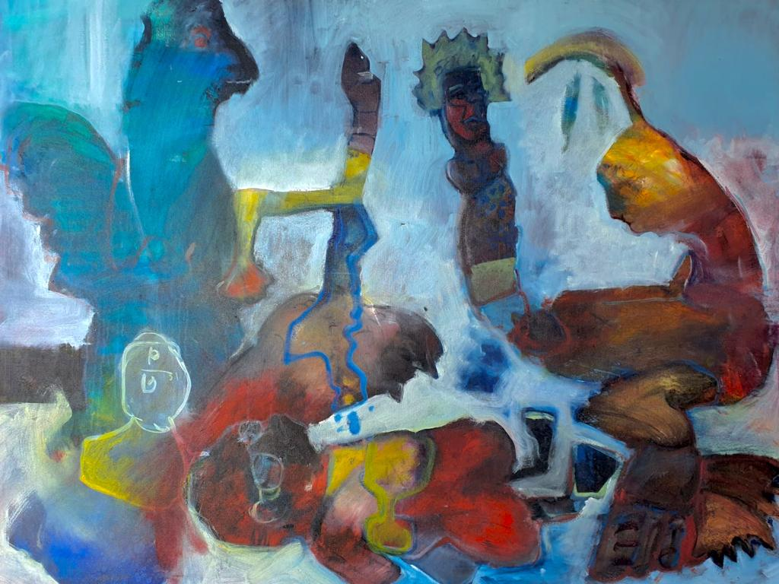
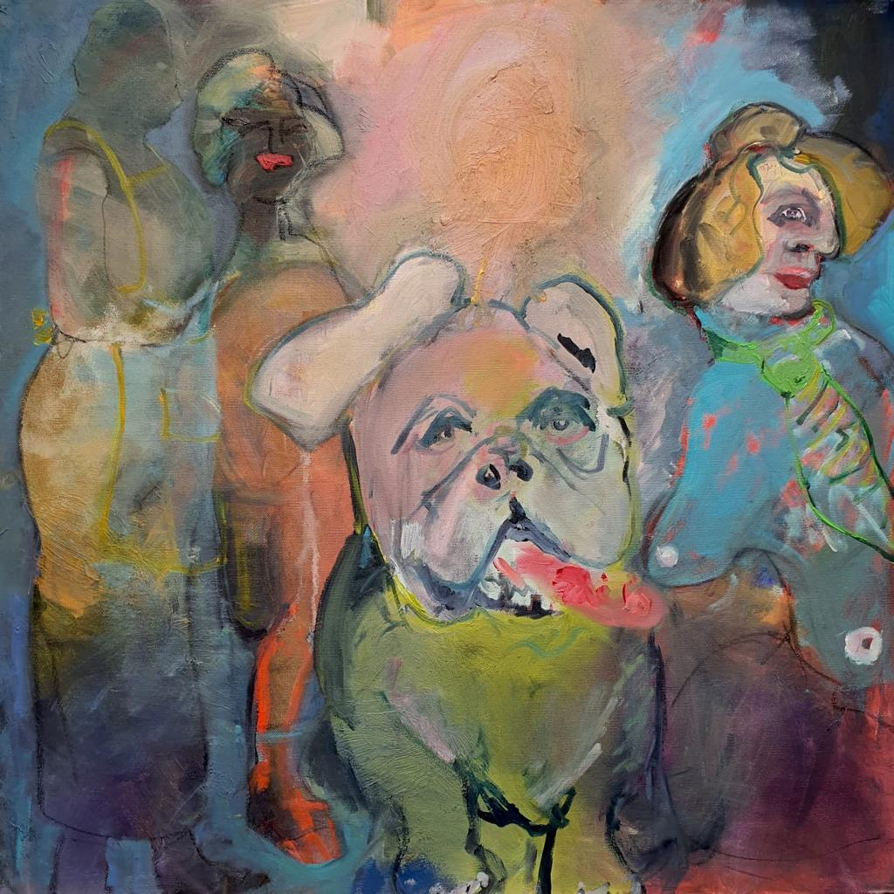
Above:
Title: Conversation 1 Media: oil on canvas
Unframed
Size: My price: R12000
Right:
Title: Conversation 2 Media: oil on canvas
Unframed
Size: My price: R9000
This is a collaboration by the chintsa collective - Pam Heaton & Sal Price.

Slide 6
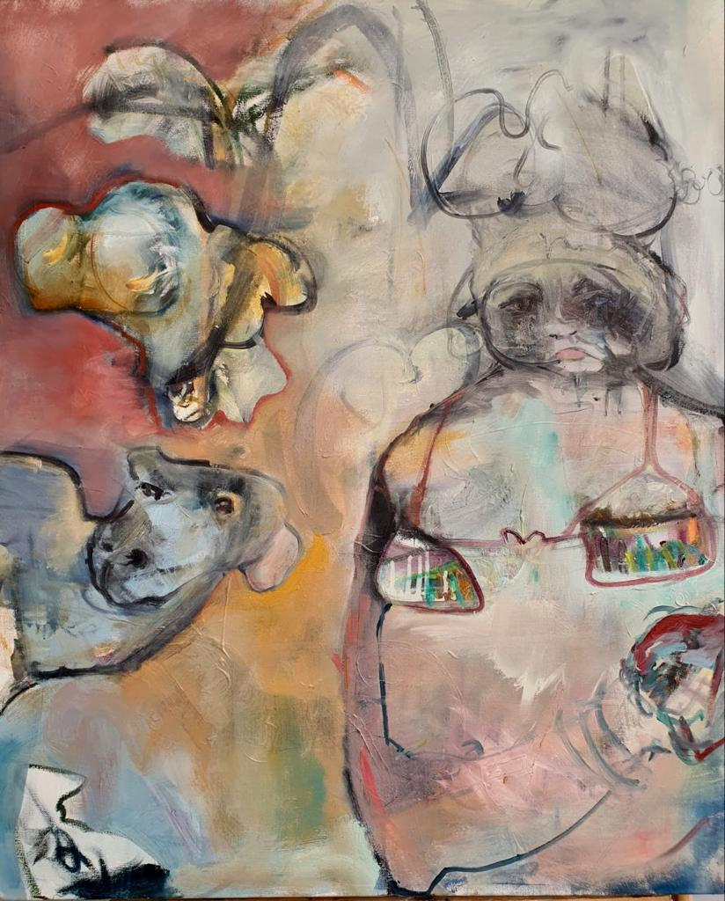
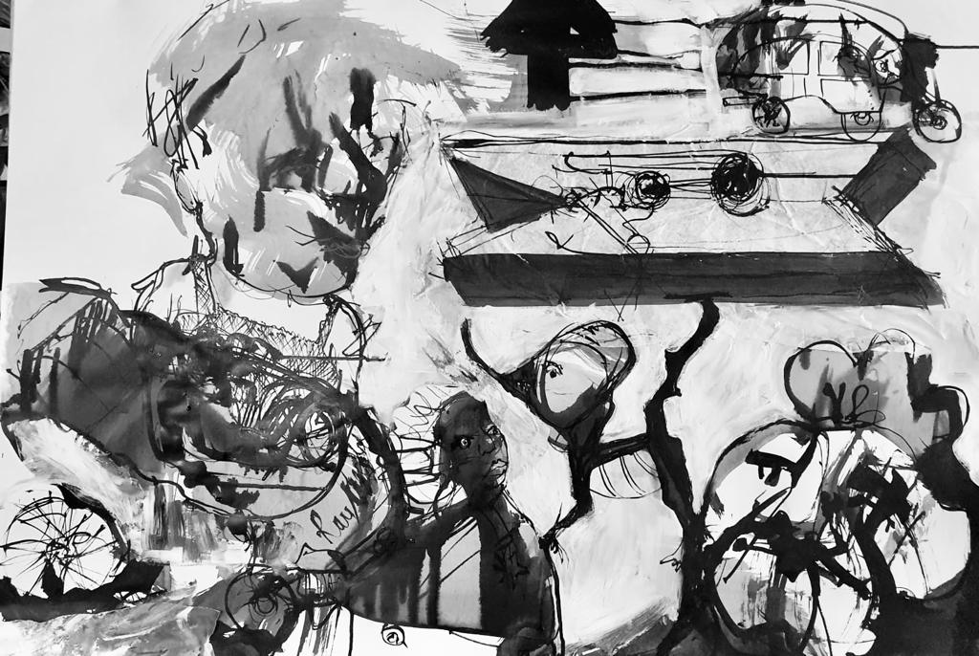
Left:
Title: Conversation 3 Media: oil on canvas
Unframed
Size: My price: R9000
This is a collaboration by the chintsa collective - Pam Heaton & Sal Price.
Right:
Title: Pegged Media: ink and mixed media on paper
Framed
Size: : 68x61 My price: R12000

Slide 7
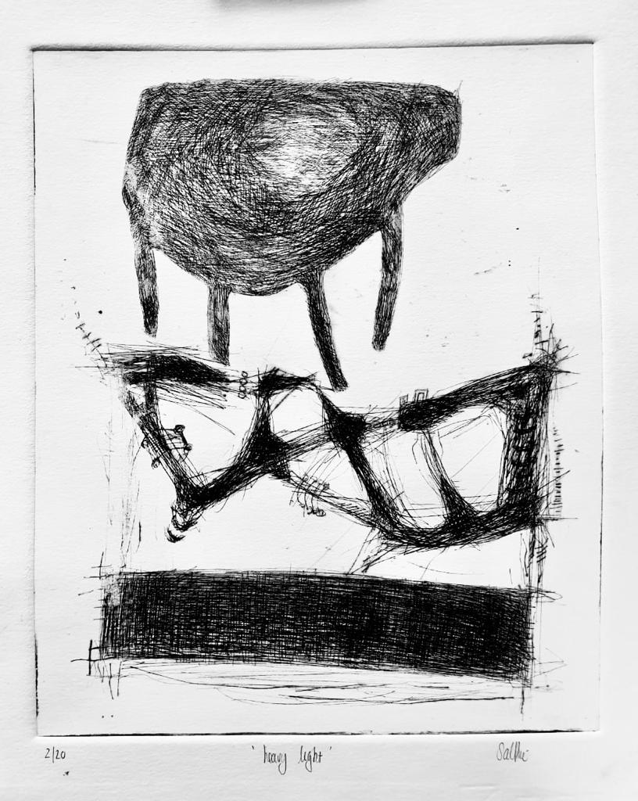
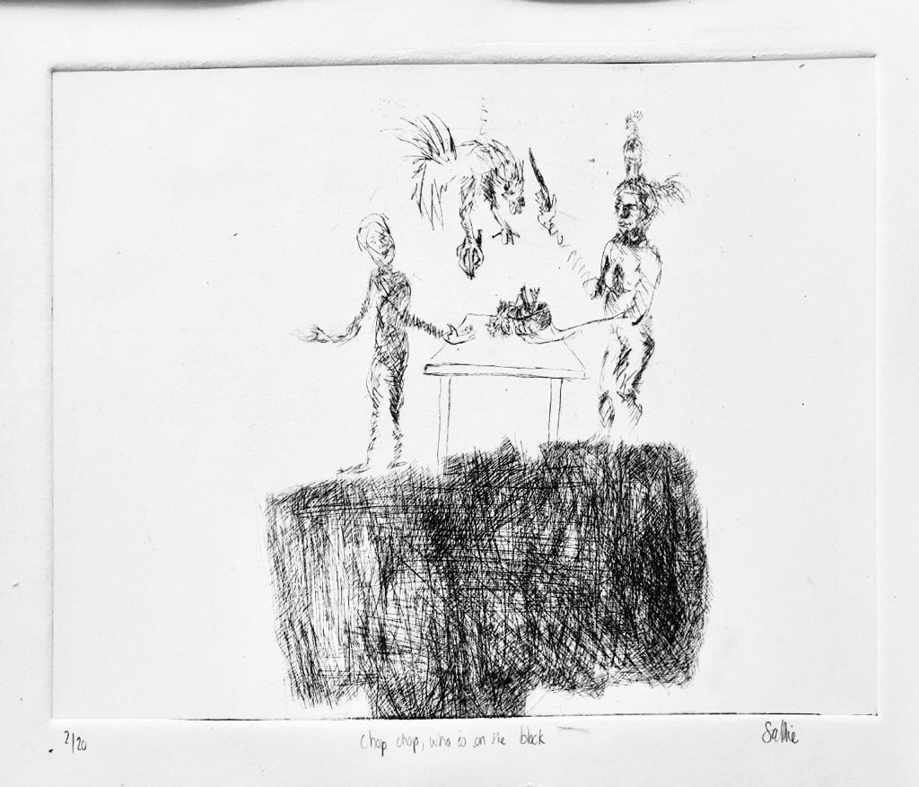
Title: Heavy light Media etching
Framed
Size: My price: R650 unframed. R1000 framed
Title: Chop chop who is on the block Media: etching
Framed
Size: My price: R650 unframed. R1000 framed

Slide 8
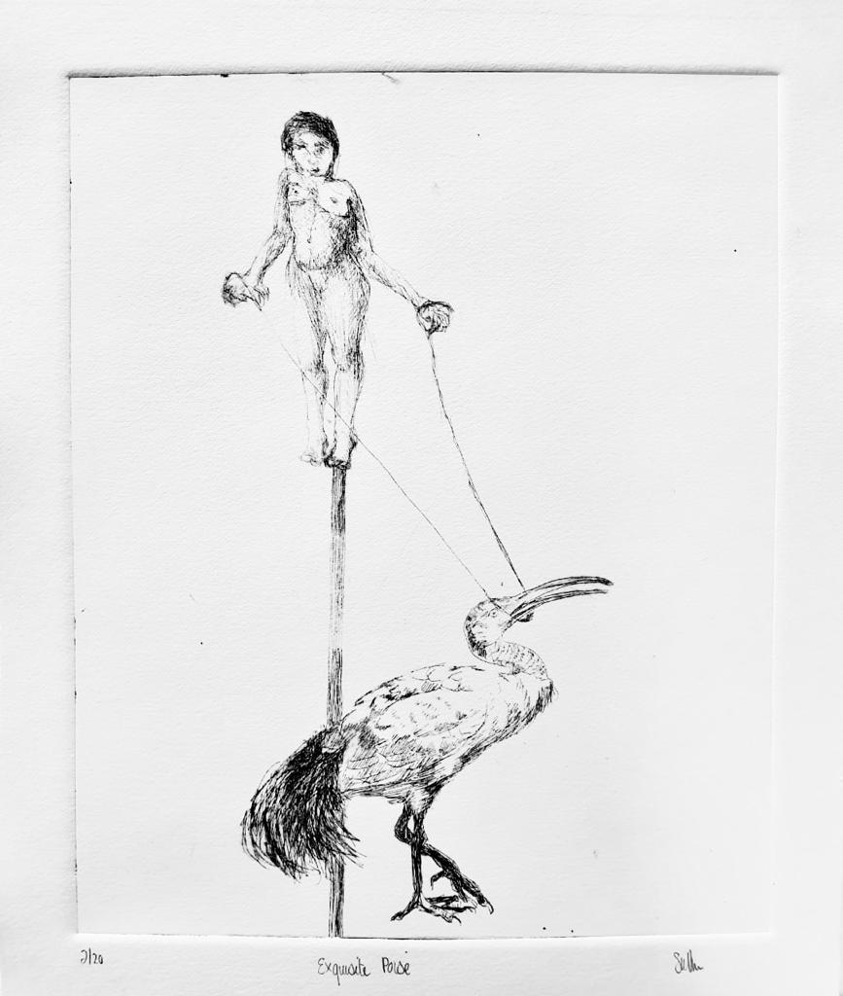
Title: Exquisite poise Media etching
Framed
Size: My price: R650 unframed. R1000 framed
Title: And David clicked Media etching
Framed
Size: My price: R650 unframed. R1000 framed

Slide 9
Title: Asleep on the wing Media etching
Framed
Size: My price: R650 unframed. R1000 framed

